Slide 1
《英语国家社会与文化入门》(下册）
The Society and Culture
of Major English-Speaking Countries
An Introduction
(Book Two)

Slide 2
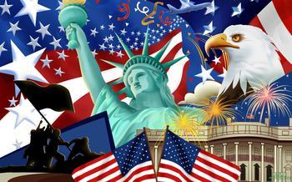
The United States of America
Unit 15 Sports and Scenic Spots in America

Slide 3
Quiz
Give the English and a brief explanation for the following:
1. 美式橄榄球
2. 美国的棒球运动
3. “飞人乔丹”
4. 大峡谷
5. 黄石国家公园

Slide 4
Focal Points
Sports:
the American Football
baseball
Jackie Robinson
the World Series
basketball
James Naismith
NBA
Michael Jordan
Scenic spots:
the Grand Canyon
Yellowstone National Park
the West Coast
Florida
the National Monument
Niagara Falls
Hawaii
Alaska

Slide 5
This Unit Is Divided into Two Sections
Sports
Scenic Spots

Slide 6
I. Sports
Football
baseball
basketball
other sports activities

Slide 7
American Football
Football is very popular in America.
American professional football is played during the late summer (preseason), the fall (regular season), and the winter until late in January (post-season, or play off time).
The National Football League (NFL) is a professional American football league. It is composed of 32 teams divided equally between the National Football Conference (NFC) and the American Football Conference (AFC).
In addition to professional football, most colleges and universities have a varsity football team.

Slide 8
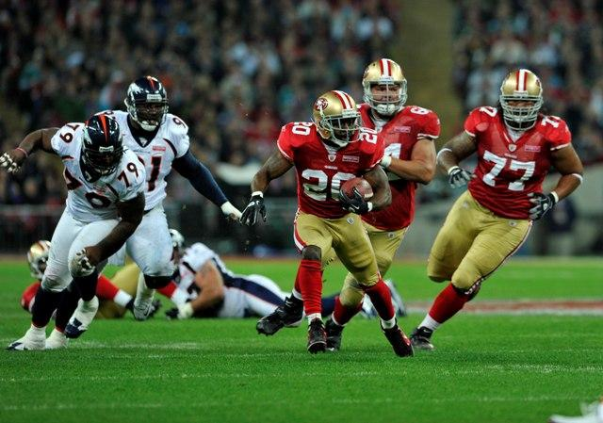

American Football

Slide 9
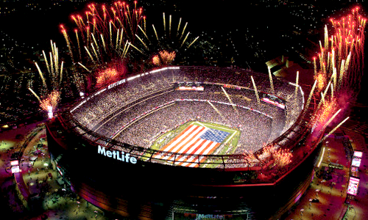
The Super Bowl
American professional football games culminate in the Super Bowl to decide the champion team for the year.

Slide 10
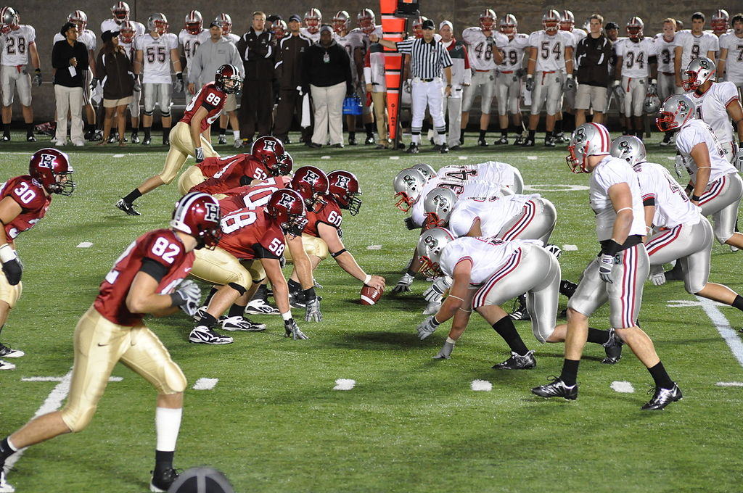
US College Football
Below: A Game between Harvard and Brown University in 2009

Slide 11
Baseball
Baseball is still regarded by many as the great American game.
In America, many children still play informal baseball in their neighborhoods. Small towns and cities still maintain organized Little League or (for older children) Babe Ruth baseball teams.
In many cities, young adults organize into informal “softball” leagues, and universities still maintain varsity baseball teams.
Professional baseball is still “big business.”

Slide 12
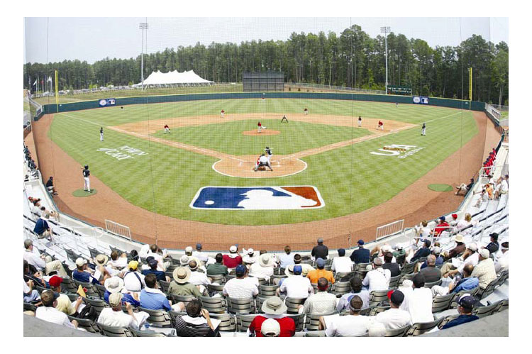
A Baseball Field

Slide 13

The World Series
The World Series between the leading teams in their respective leagues takes place in the latter part of October. The best four out of seven games determines the World Series Champions.

Slide 14
Basketball
Basketball is very popular in America. It was deliberately created in 1891 by a physical education teacher in Massachusetts to provide an indoor sports activity during the snowy winter months when outdoor playing fields could not be used.
The basic rules of the game have not much changed since then.
Today, however, there are many basketball courts set up out of doors, and youngsters frequently fix a hoop to a convenient post or even a wall in order to practice playing the game.

Slide 15
National Basketball Association (NBA)
The first professional basketball in 1896.
In 1949 the National Basketball Association (NBA) of professional teams was established. For the next thirty years, professional basketball did not have much of an audience.
In 1979 two college players, Larry Bird of Indiana State University and Magic Johnson of Michigan State University motivated an increased interest in the game through their friendly rivalry.

Slide 16

Women’s National Basketball Association (WNBA)

Slide 17
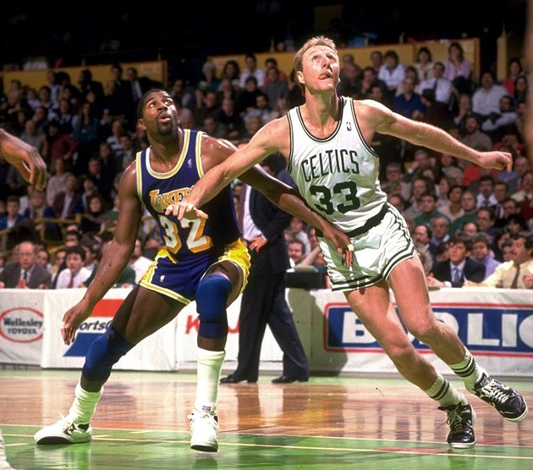
Larry Bird and Magic Johnson
Larry Bird subsequently joined the Boston Celtics, and Magic Johnson the Los Angeles Lakers. Both teams dominated the professional game through the 1980s and are still among the best basketball teams in America today.

Slide 18
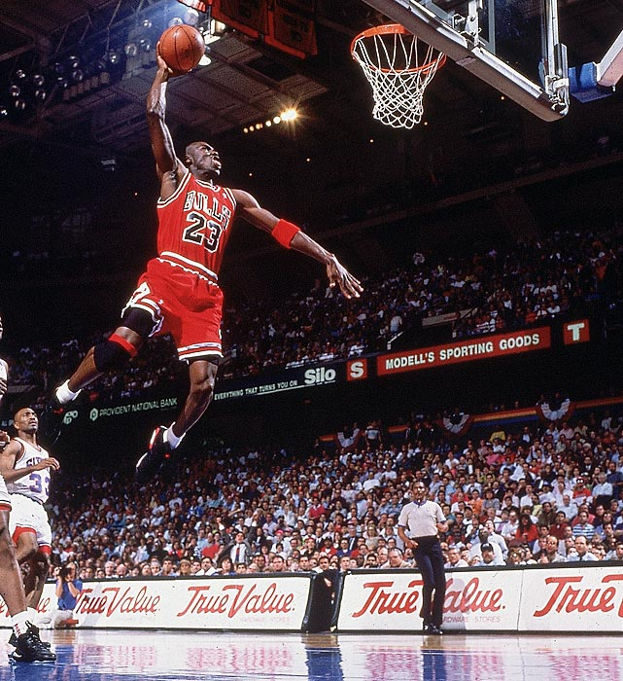
Michael Jordan
The greatest basketball player of all time is thought to be Michael Jordan, well-known not only in the States but elsewhere in the world, including China. Jordan joined the NBA’s Chicago Bulls in 1984. He emerged as a league star and his leaping ability earned him the nickname “Air Jordan”. He led the Bulls to six NBA championships from 1991 to 1998.

Slide 19
Other Sports
Ice hockey: It was first played in Canada and states bordering that country. Yet it has spread throughout the United States with professional teams all over the country.
Track and field: They are very popular, and Americans support racing of all sorts: horses, dogs, automobiles, and bicycles.
Court games: Such as tennis, racket ball, volleyball, field hockey, and lacrosse have increasing supporters, and soccer has gained new spectators daily.
Golf and bowling: These sports have many amateur participants, and sponsored matches are watched by many on television.
Boxing: Both amateur and professional, boxing has a large number of followers, nourished unfortunately by the urge to wager money.

Slide 20
Scenic spots
the Grand Canyon
Yellowstone National Park
the West Coast
Florida
the National Monument
Niagara Falls
Hawaii
Alaska

Slide 21
The Grand Canyon
The Grand Canyon is America’s most famous scenic wonder.
It is a gorge slowly carved away for nearly 6 million years by the waters of the Colorado River.
This scenic area is a U.S. National Park, established in 1908, and has continually incorporated more and more territory until, in 1975, the entire Grand Canyon, a total of 4930 sq km, is within the boundaries of the Grand Canyon National Park.
Millions of people each year visit this place to see this spectacle of nature.

Slide 22
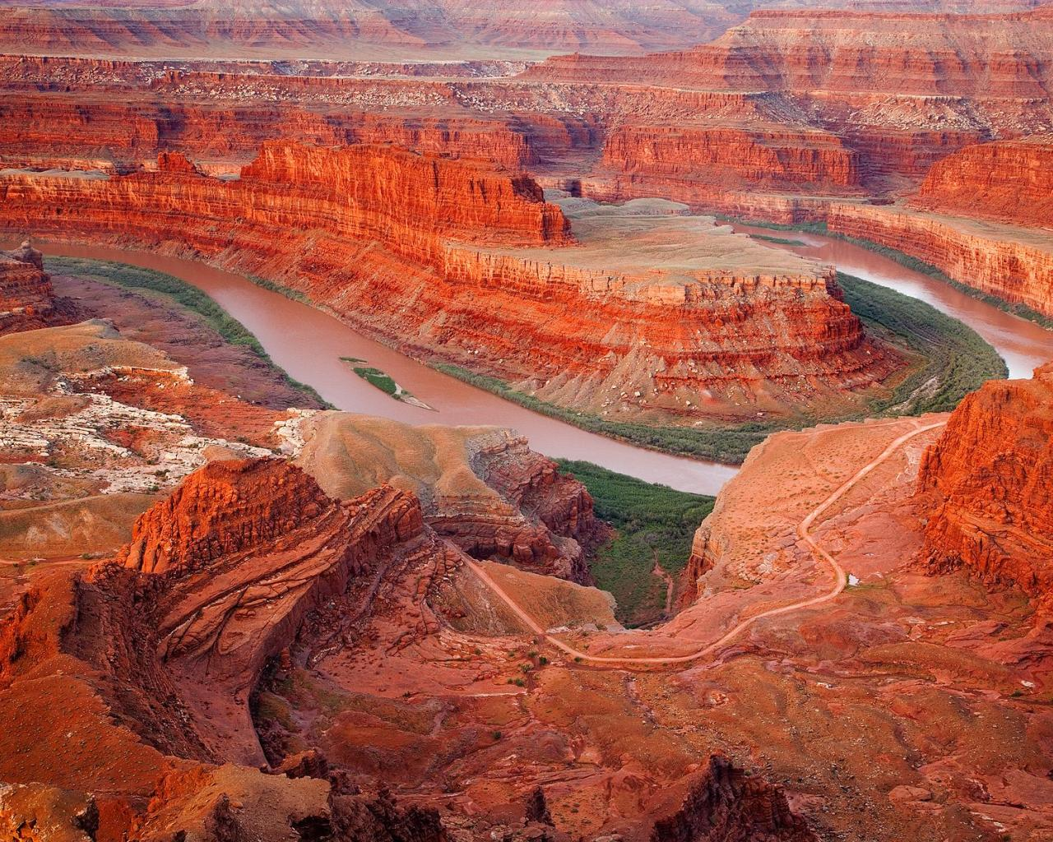
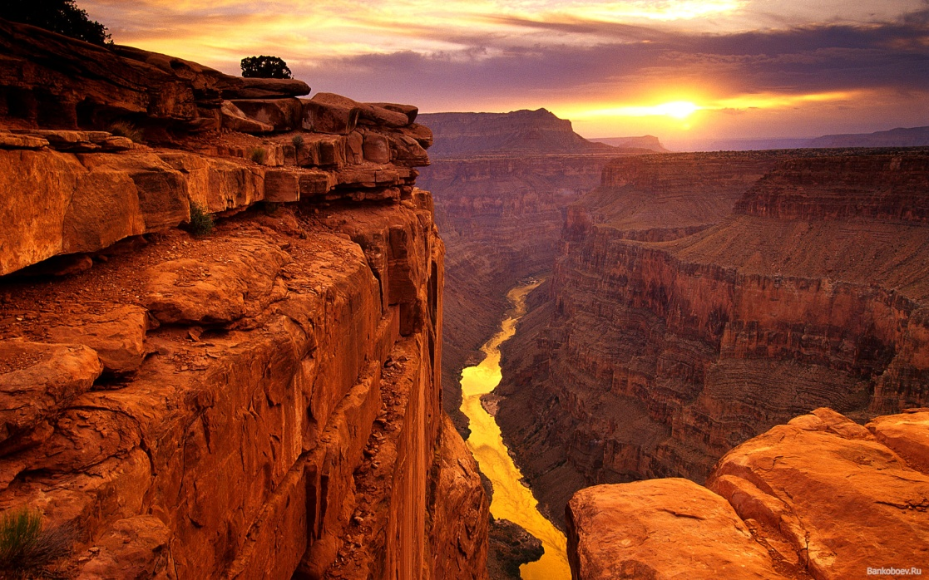
The Gran Canyon

Slide 23
Yellowstone National Park
Yellowstone National Park is located primarily in the U.S. state of Wyoming, although it also extends into Montana and Idaho. It is named after for the river flowing through the area.
The park was established in 1872, and is the oldest of the national parks and also one of the largest, being almost 8 985 sq km in area.
It is known for its geysers and hot springs, the most famous of the geysers being Old Faithful, which every hour or so sends an enormous plume of water and steam shooting high into the sky for a few minutes.
There are hot springs and pools of bubbling warm mud in the park.
The park also contains beautiful vistas of waterfalls, rugged peaks, and lush valleys. The woodlands are home to many types of wildlife, especially rare species of birds.

Slide 24
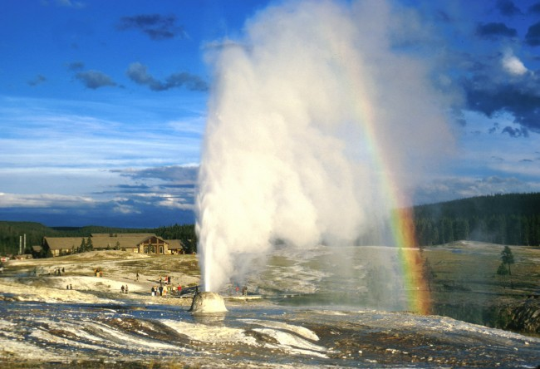
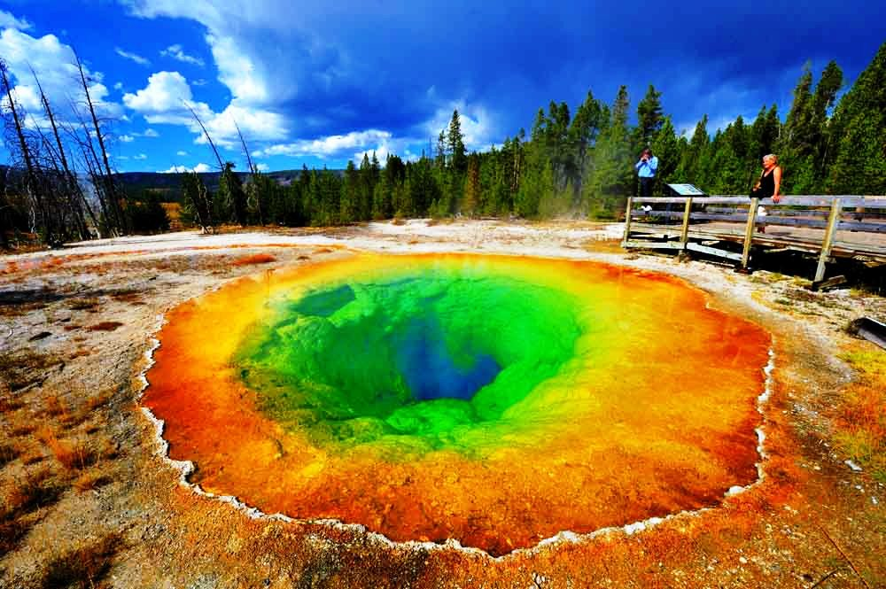
Yellowstone National Park

Slide 25
The West Coast
On the West Coast, the city of San Francisco remains an important center of urban sightseeing, with Berkeley and its University across the Bay, and Stanford University a short distance south of San Francisco.
South of San Francisco is Yosemite National Park with its spectacular scenery of valleys carved out by glaciers, and numerous magnificent waterfalls.
Further south is Monterey, the scene of many John Steinbeck stories.
In Southern California, most of the interest lies in human creations such as Hollywood and Disneyland.

Slide 26
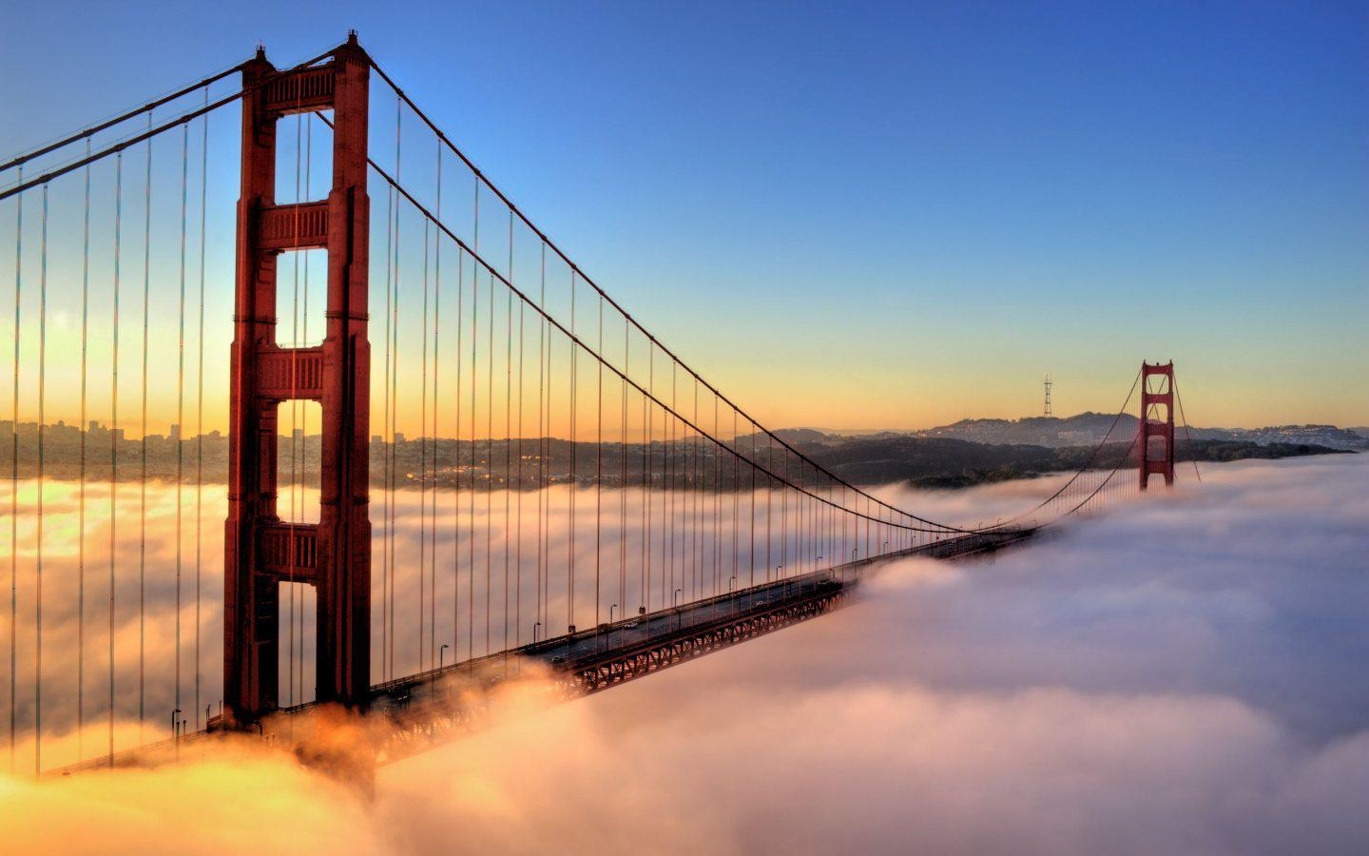
Golden Bridge in San Francisco

Slide 27
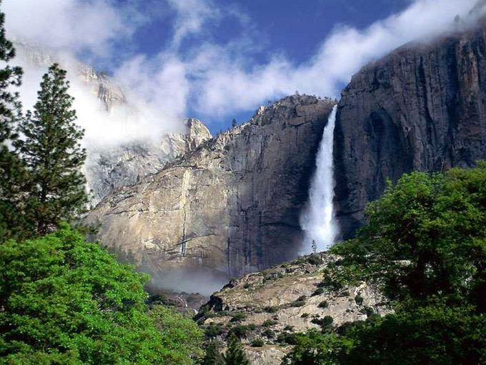
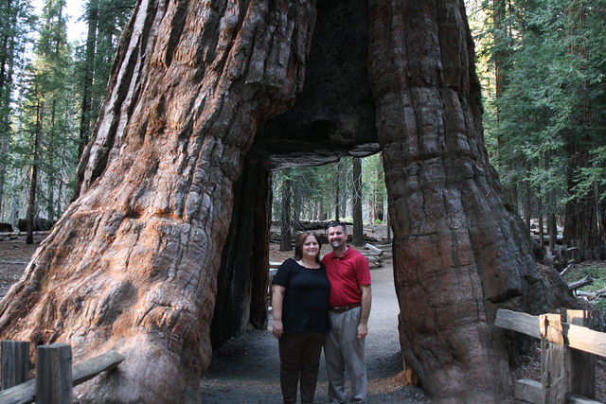
Yosemite National Park

Slide 28
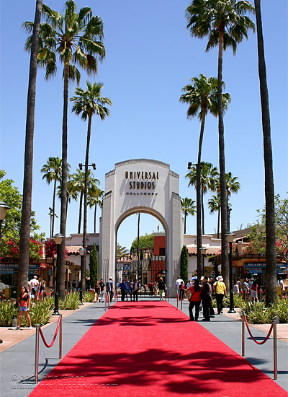
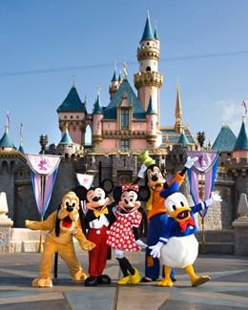
Hollywood and Disneyland

Slide 29
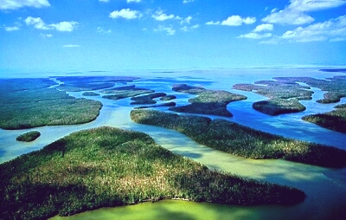
Florida
The southernmost tip of the eastern United States is the state of Florida. Here the climate is mild all year, famous for beaches.
In south Florida is the Everglades, approximately 13000 sq km in size, where the Everglades National Park occupies about 6100 sq km. The Everglades is a subtropical wetlands (left).

Slide 30
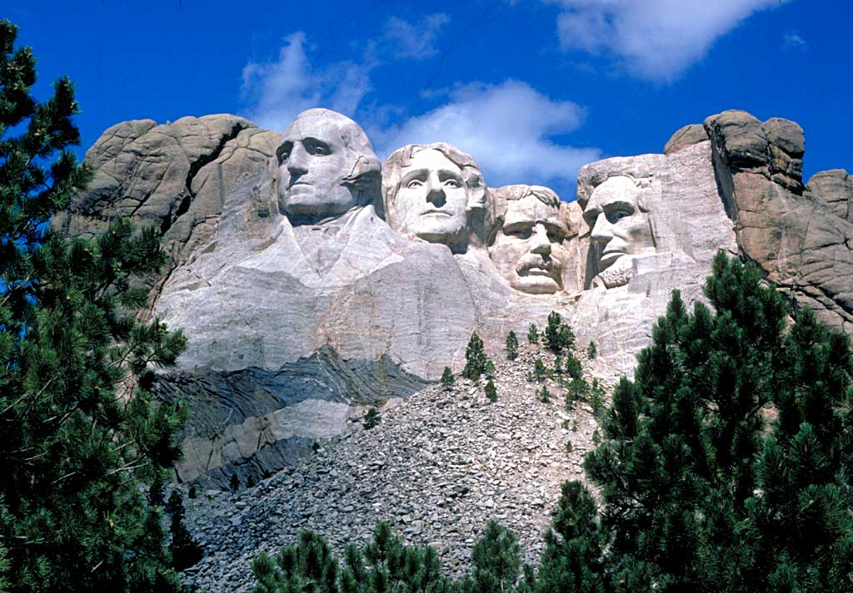
The National Monument
In the state of South Dakota, is the National Monument which is an unusual artistic project at Mt. Rushmore, where enormous portraits of four famous U.S. Presidents: George Washington, Thomas Jefferson, Abraham Lincoln, and Theodore Roosevelt, are sculpted on the face of the 1730 meter high mountain.

Slide 31
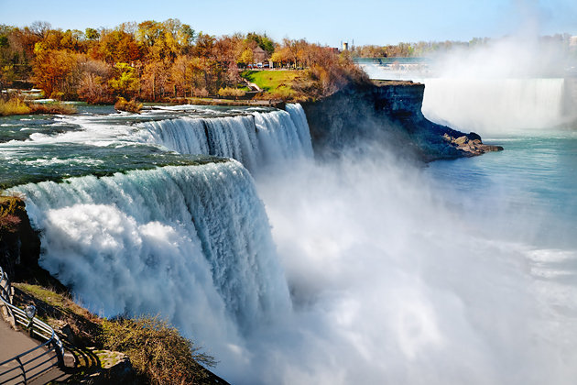
Niagara Falls
Niagara Falls is an awe inspiring, dynamic display of a torrent of water freely falling over a precipice for a distance of 55 m. The spray created by the falling water, visible from miles away, and the roaring sound of water striking the rocks or river below never fail to impress spectators with the wonders of natural forces.

Slide 32
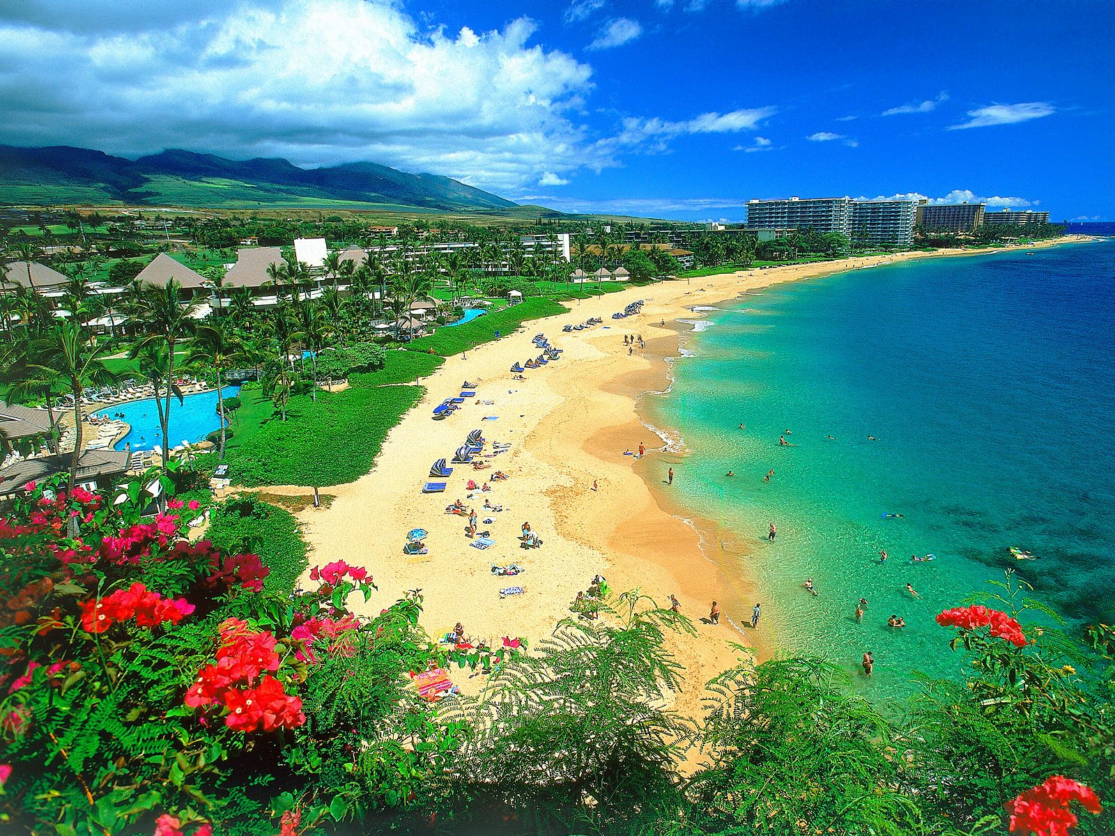
Hawaii
Hawaii is made up of a chain of islands— 124 islets and 8 main island stretching 1523 miles in the Pacific. In total, the islands spread across an area of 6,459 square miles. Each of the islands is the top of a submerged volcanic mountain.

Slide 33
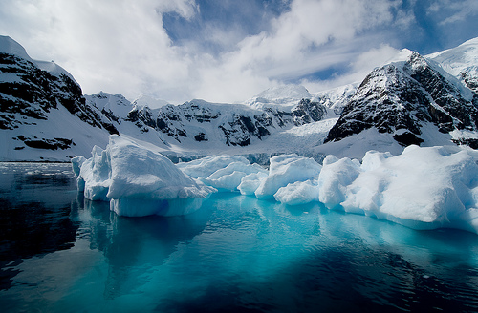
Alaska
Alaska is the largest state of the United States by area. Situated in the northwest extremity of the North American continent, it has vast expanses of land covered with ice and snow, and half of the world’s glaciers are found here.

Slide 34
Questions for Discussion
A. Why do you think many people love sports? In what way do sports reflect American culture?
B. Football, baseball, and basketball are the three most popular sports in the US. Are they popular in China? Why/Why not?
C. After reading this unit, which of the places mentioned in the text do you want to visit most? Why?
D. List what you consider to be the ten most interesting places to visit in China. Give reasons for your selection.

Slide 35
The End
高等教育出版社
2015

